Slide 1
Evaluation of the effects of an ACT based intervention for Ice hockey players: a randomized controlled trial Lundgren, T., Jader, E., et al. Under preparation
Karolinska Institutet, Department of Clinical Neuroscience & Centre for Psychiatry Research and Education, Stockholm County Council
Department of psychology, University of Stockholm
MODO HOCKEY

Slide 2
Thanks to!
MODO hockey
Markus Näslund, Per Svartvadet, Ulf Samuelsson, youth coaches, Players and my studentsJohan Eriksson, Jonathan Kotschack, Emil Jäder, Olle Lööf, Maria Larsen and Oscar Anderbladh

Slide 3
Background
Heart of hockey research center
Design studies on as much as we can
Make an impact in the organization, coaches, staff and players.
Neuropsychological evaluation related to performance and game intelligence
AAQ for hockey (VAMS), single subject designs, controlled group study and the RCT presented here.

Slide 4
Method
Design: Randomized Controlled Trial, N=40
Pre, post and 3 month follow up,
Repeated measures ANOVA, effect size and post hoc tests was calculated.
No significant group differences at pre.
IV= ACT vs Waitlist control
Matched groups:
Skill (national team players), age, and position on the ice (defenders, forwards and goalies) were accounted for.
Notes:
This RCT utilized pre, post, and 3 month follow-up data collection procedures with no statistically significant differences between groups pre intervention.
Inferential statistics were utilized to evaluate outcome effects across the two groups.
Groups were matched based on age, position, and skill level (i.e. elite non-elite).

Slide 5
Method
Dependent variables: Goals, assists, total points, coach ratings (blind), and players evaluation of training.
Total of 4 hours training with homework between sessions
Same structure of each session
Session Purpose
Summary of last session
Experiential exercise
Homework assignment
Notes:
Dependent measures evaluating the effects of ACT protocols on goals assists and self-reports were taken.
Independent/intervention variables included a 4 session act protocol in which athletes were introduced to the purpose of the session, reviewed and discussed the lass session goals and homework, participated in a relevant experiential exercise, and then were assigned homework for the next session.

Slide 6
Intervention
Aim: create a flexible ice hockey player who reacts on what happens on the ice and chose actions based on values.
Train them to be researchers on their own hockey development.
Base the work on an functional analysis.
Give each player training material.
Lots of feedback between sessions
Strive to make it experiential We want to broaden behavior repertoires where unworkable olds ones are usually chosen.

Slide 7
Flexible &
Present player
Reacting on
“whats out on
The ice”
Experiences “bad”
Reacting to emotion, fears
Instead of reality
Effective action
Emotions ok!
Rigid
action
pattern
Thoughts ok!
7
Notes:
In essence the Hockey players were taught to allow thoughts and self-stories to occur with out judgment or a need to control them while equally allowing themselves to focus on what was on the ice.
Side thought: It would be interesting to see if the interventions impacted fouls and aggression on ice?
7

Slide 8
Intervention
Session 1:
Values and commitment
Exercises (hockey life line, get focused hockey App)
Metaphors
Homework (values game work sheet, mindfulness to practice refocusing, preparation B-E)
Session 2:
Defusion and flexible attention training
Exercises (Juggle while under attack of experiences, Sing a song)
Metaphors
Homework (mindfulness to practice refocusing, refocus during games and practices
Notes:
Each individual intervention session covered the following key components of the ACT hexiflex.

Slide 9
Intervention
Session 3:
Acceptance and willingness to experience whatever is available in the present context
Exercises (carry experiences close to you, increase persistence by making room for experiences “holding your breath”)
Metaphors
Homework (mindfulness to practice refocusing, values challenge of the week, post game work sheet)
Session 4:
Repetition of open, aware and engaged
And importance of practice
Exercises (triggers, eyes on, summary of the course,)
Metaphors
Homework (mindfulness to practice refocusing, feedback on hockey development)

Slide 10
Post game exercise to save mental energy
Three step model for post game work:
Aim: systematic approach to mental work, develop your skills as a player, and shorten the time for rumination
1) Set a time, say 1 hour. During that hour you are happy, angry or disappointed. Be with what ever is present.
2) Think about your game, is there anything you want to change or do differently? What did you do good? (write it down in your post game sheet)
3) Close the books (bokslut) for the game and use the skills we practiced on to do other things (engage in other areas in life, family, friends, girlfriends etc

Slide 11
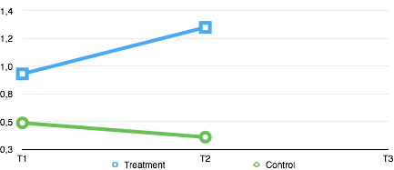
Results: Total Points Effect sizes (ES) in ETA Squared 0,01 = small effect 0,06 = moderate effect, 0,14 = large effect
Mean of Assists + Goals
p = 0,027
F = 5,359
ES = 0,15
Notes:
Immediately post intervention data indicate a drastic improvement in overall assist and goal performance for the treatment condition. Effect size and power analysis further support the positive gains of the intervention.

Slide 12
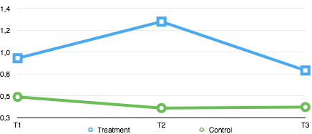
Total points: At Follow Up
p = 0,950
F = 0,004
ES = 0,00
Mean of Assists + goals
Notes:
Post intervention follow up at 3 months does not indicate sustained behavior change. Such data, in light of other ACT intervention follow up data warrant further investigation into this finding.

Slide 13
On Ice Performance Summary
Approximately 50 % increase in total points in the ACT group at post. However no long term effects was established.
Significant effects between pre and post but not sustained at follow up.
Notes:
Overt hockey performance data indicate performance difference post interventions, and while this change did not sustain the approximately 50% increase in total points accumulated by the ACT group warrant further investigation regarding protocols and procedures that would support post intervention behavior change.

Slide 14
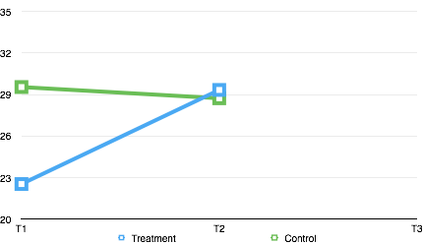
Coach ratings (blind)
Mean ratings : Athlete dedication, focusing ability, performance
p = 0,012
F = 7,440
ES = 0,24
Notes:
Consumer satisfaction data on both the coaching and athlete’s perspective was collected.
From this data it is recognized both graphically (cause I’m a behavioral nerd) and statistically that Coaches note an improvement in athlete performance.

Slide 15
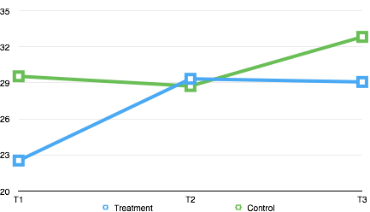
Coach Evaluation
Mean rating: Athlete dedication, focusing ability, performance
p = 0,265
F = 1,304
ES = 0,05
Notes:
This change is sustained at post study follow up.

Slide 16
Coach Evaluation Summary
Coaching staff report a marked improvement (significant) in athletes, especially during training, when Athletes were exposed to ACT interventions.
Effects maintained over the three months period.

Slide 17
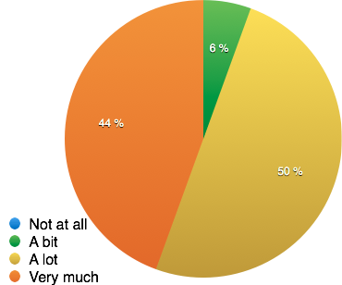
Players Evaluation
Has the intervention been important for you as an ice hockey player?
Notes:
Athlete self evaluations also indicated value of the intervention across three important variables. It is also interesting to note that, no athlete indicated the ACT protocols as not or unhelpful.

Slide 18
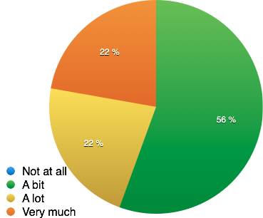
Players Evaluation
Has the intervention helped you develop as an ice hockey player?
Notes:
It is cool that all athletes at a elite level indicate that ACT helped them improve their performance and some not even just a little bit, but improved their performance by a lot.

Slide 19
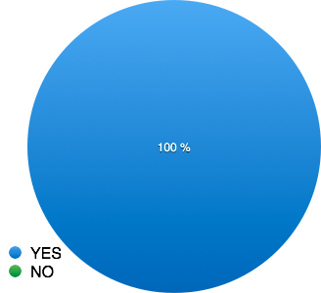
Athlete Evaluation
Would you recommend others to take the course?
Notes:
And how cool is that?!

Slide 20
Conclusions and future research
ACT effects the performance for elite hockey players.
Even when a a relatively brief intervention is used.
However, long term effects are not established.
Future research
Longer trainings?
Involve coaches more?
Establish better training equipment specifically for hockey players.
Develop the material
Notes:
In conclusion this RCT provides striking evidence for the potential impact of ACT protocols to elite performing populations and also provides future questions to be researched.
We see a positive impact in overall performance immediately preceding intervention, with little to no maintain at follow up (an odd finding for the ACT world). As a result the researchers propose the following investigations for follow up.

Slide 21
Thanks for your time
Tobias.lundgren@psychology.su.se

